Slide 1
About my six-month backpacking
About my six-month backpacking
소프트웨어학과 - 201636417 심우석
MEETING DATE & TIME
Main subject to discuss

Slide 2
TABLE OF CONTENTS
01
02
03
04
Introduction
Description
1. Overview
2. Concept
1. Description of the contents of each HTML page used
Function
Appendix
1. Analysis of function utilization
1. Appendix

Slide 3
01
Introduction
Overview
Concept

Slide 4


About my six-month backpacking
I was discharged the army, worked part-time, saved money, and went backpacking for six months.
After I went on a trip, I didn’t write it down properly, so I’m going to write it down through this assignment.
Written in diary and blog format.

Slide 5
1. Introduction
Main page
Easten Europe
Easten Europe
Overview and Introduction
Germany and
Czech Republic
Austria and Hungary
Western Europe
Western Europe
USA
Italy, Switzerland
and France
Spain, Portugal
and UK
Western US

Slide 6
02
Description
1. Description of the contents of each HTML page used

Slide 7
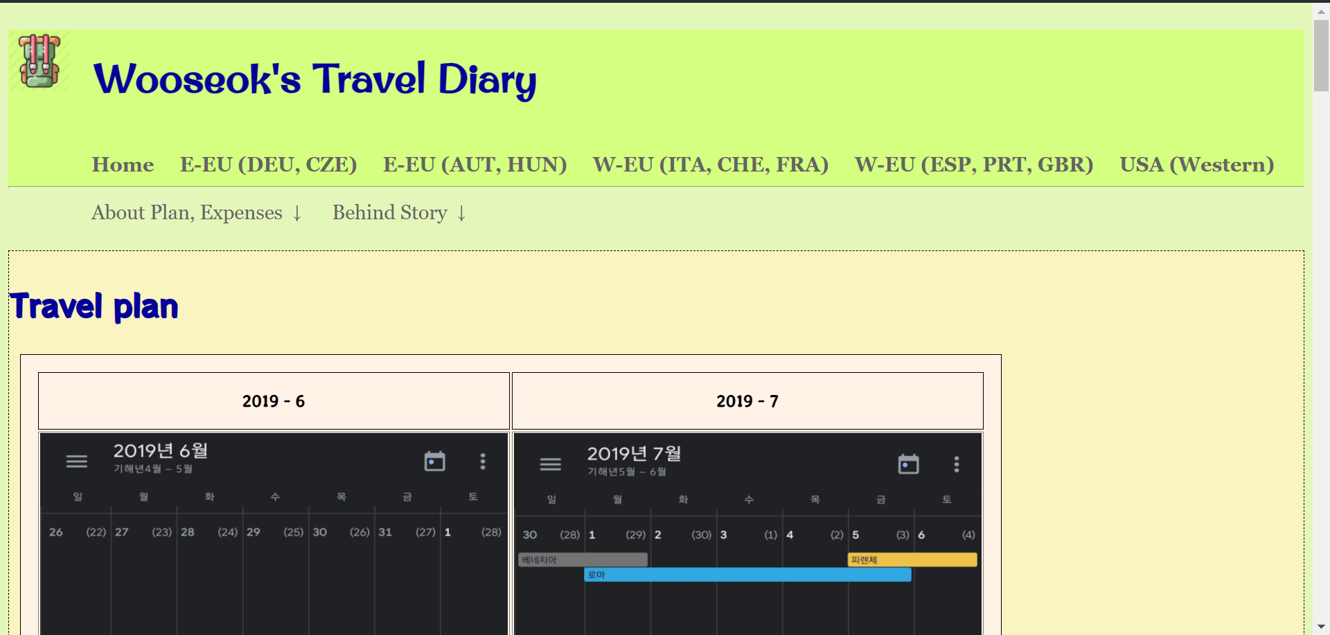
About my six-month backpacking
Main page
The Main page showed travel plans, travel expenses, travel maps and why I traveled.

Slide 8
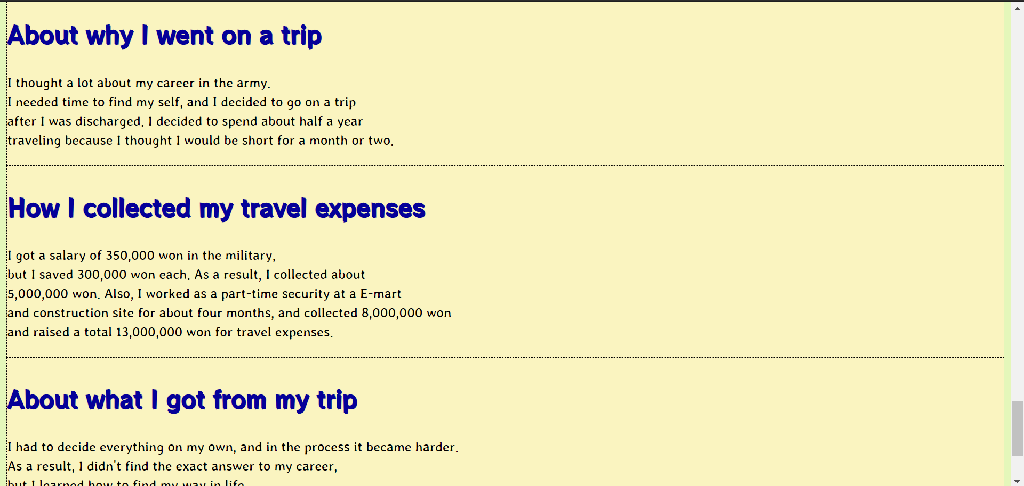
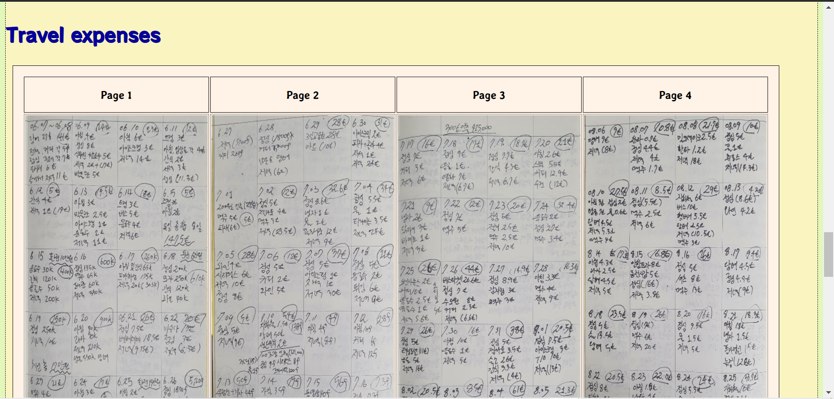
About my six-month backpacking
Main page

Slide 9
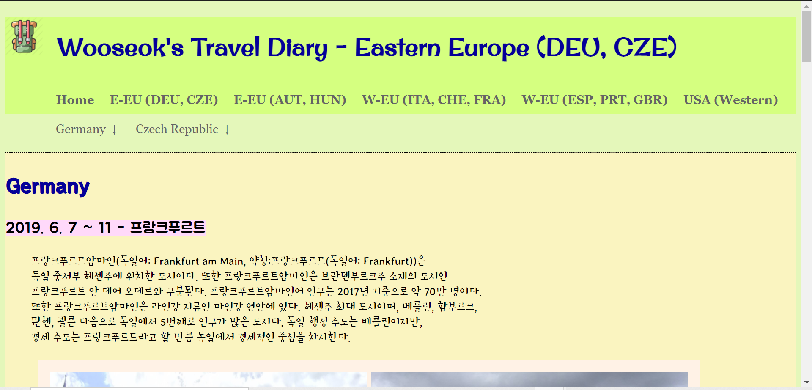
About my six-month backpacking
Eastern Europe 1
The E-EU(DEU,CZE) page displays information and photographs of cities visited from Germany and the Czech Republic.

Slide 10
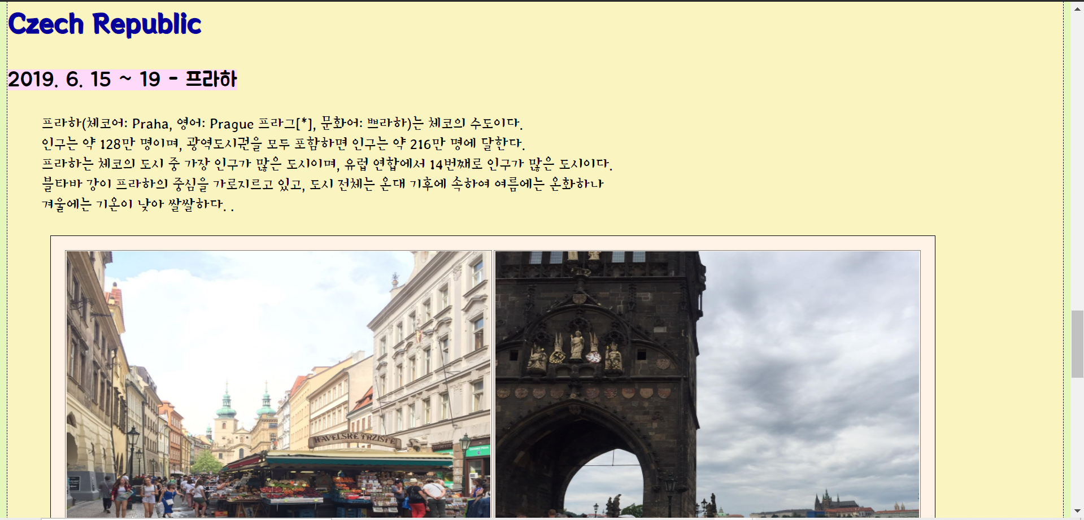
About my six-month backpacking
Eastern Europe 1
The E-EU(DEU,CZE) page displays information and photographs of cities visited from Germany and the Czech Republic.

Slide 11
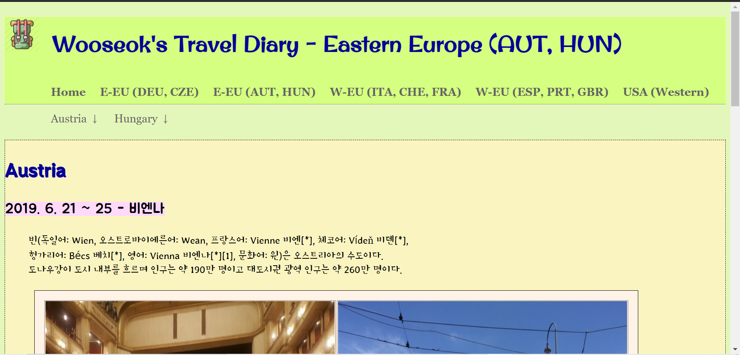
About my six-month backpacking
Eastern Europe 2
The E-EU(AUT,HUN) page displays information and photographs of cities visited from Austria and the Hungary.

Slide 12
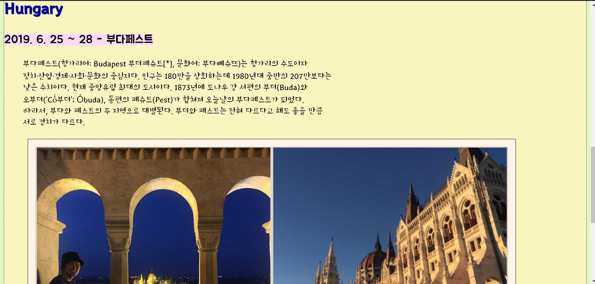
About my six-month backpacking
Eastern Europe 2
The E-EU(AUT,HUN) page displays information and photographs of cities visited from Austria and the Hungary.

Slide 13
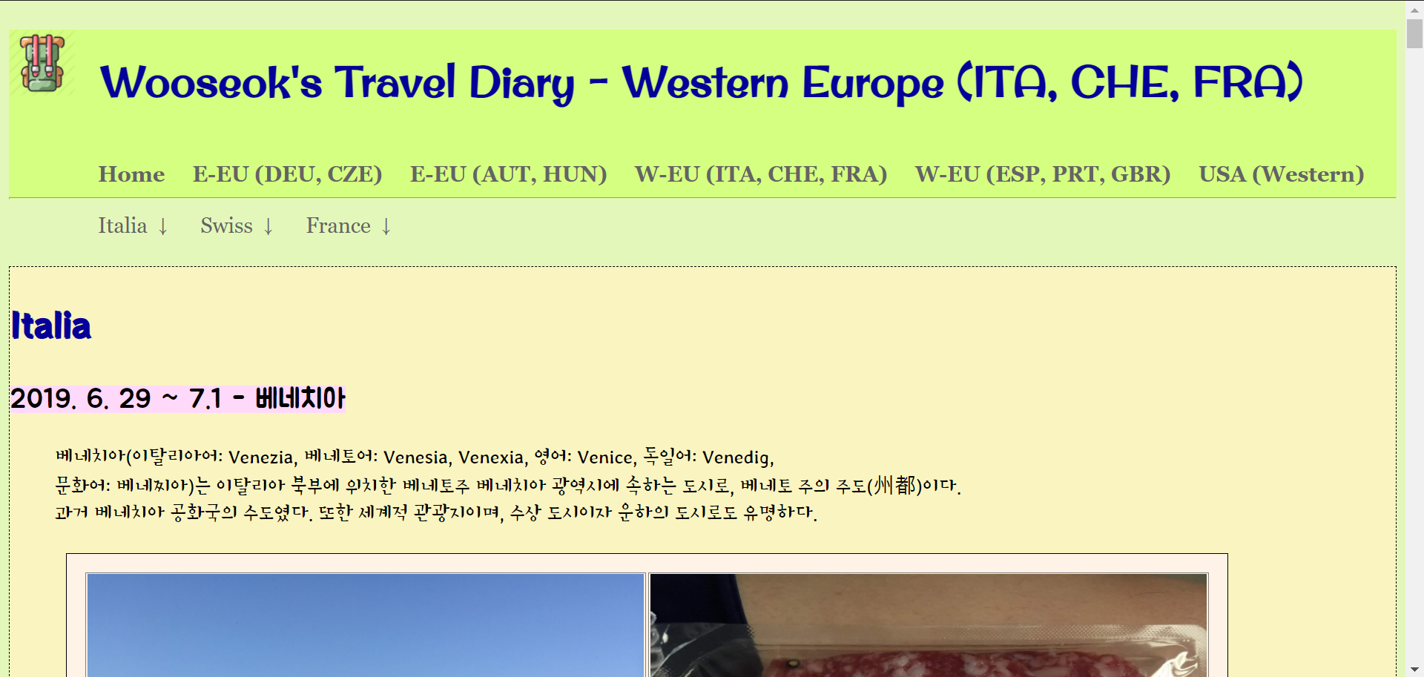
About my six-month backpacking
Western Europe 1
The W-EU(ITA, CHE, FRA) page displays information and photographs of cities visited from Italia, Swiss and the France.

Slide 14
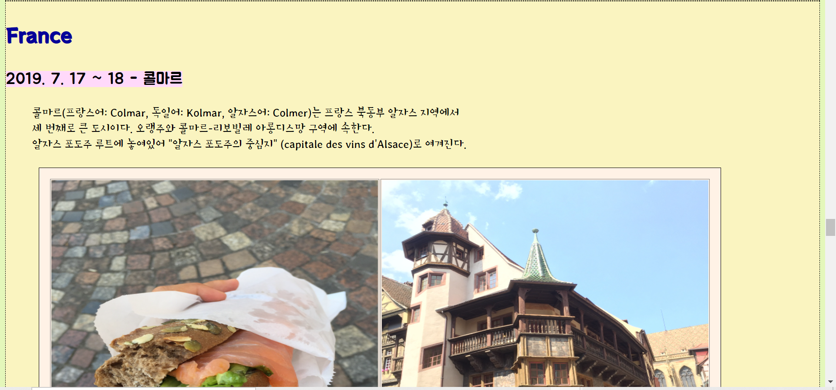
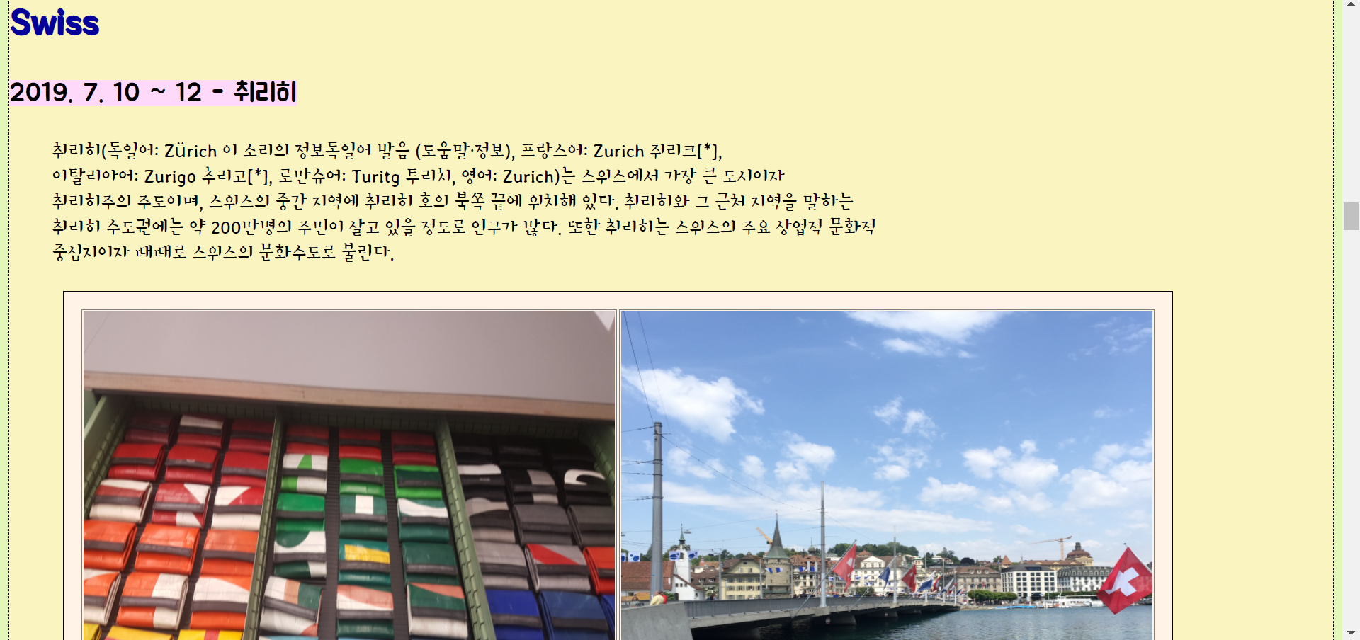
About my six-month backpacking
Western Europe 1

Slide 15
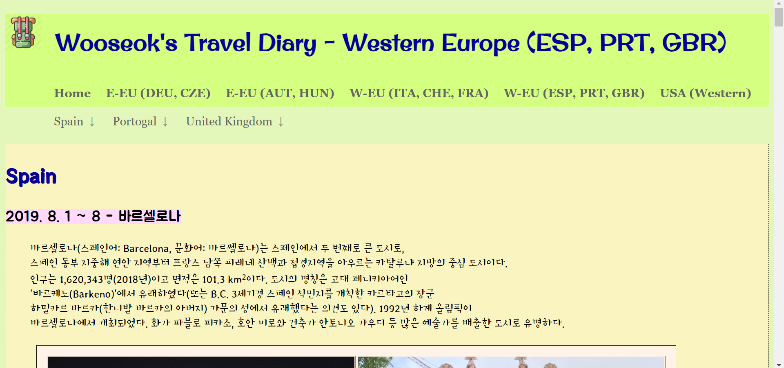
About my six-month backpacking
Western Europe 2
The W-EU(ESP, PRT, GBR) page displays information and photographs of cities visited from Spain, Portugal and the England.

Slide 16
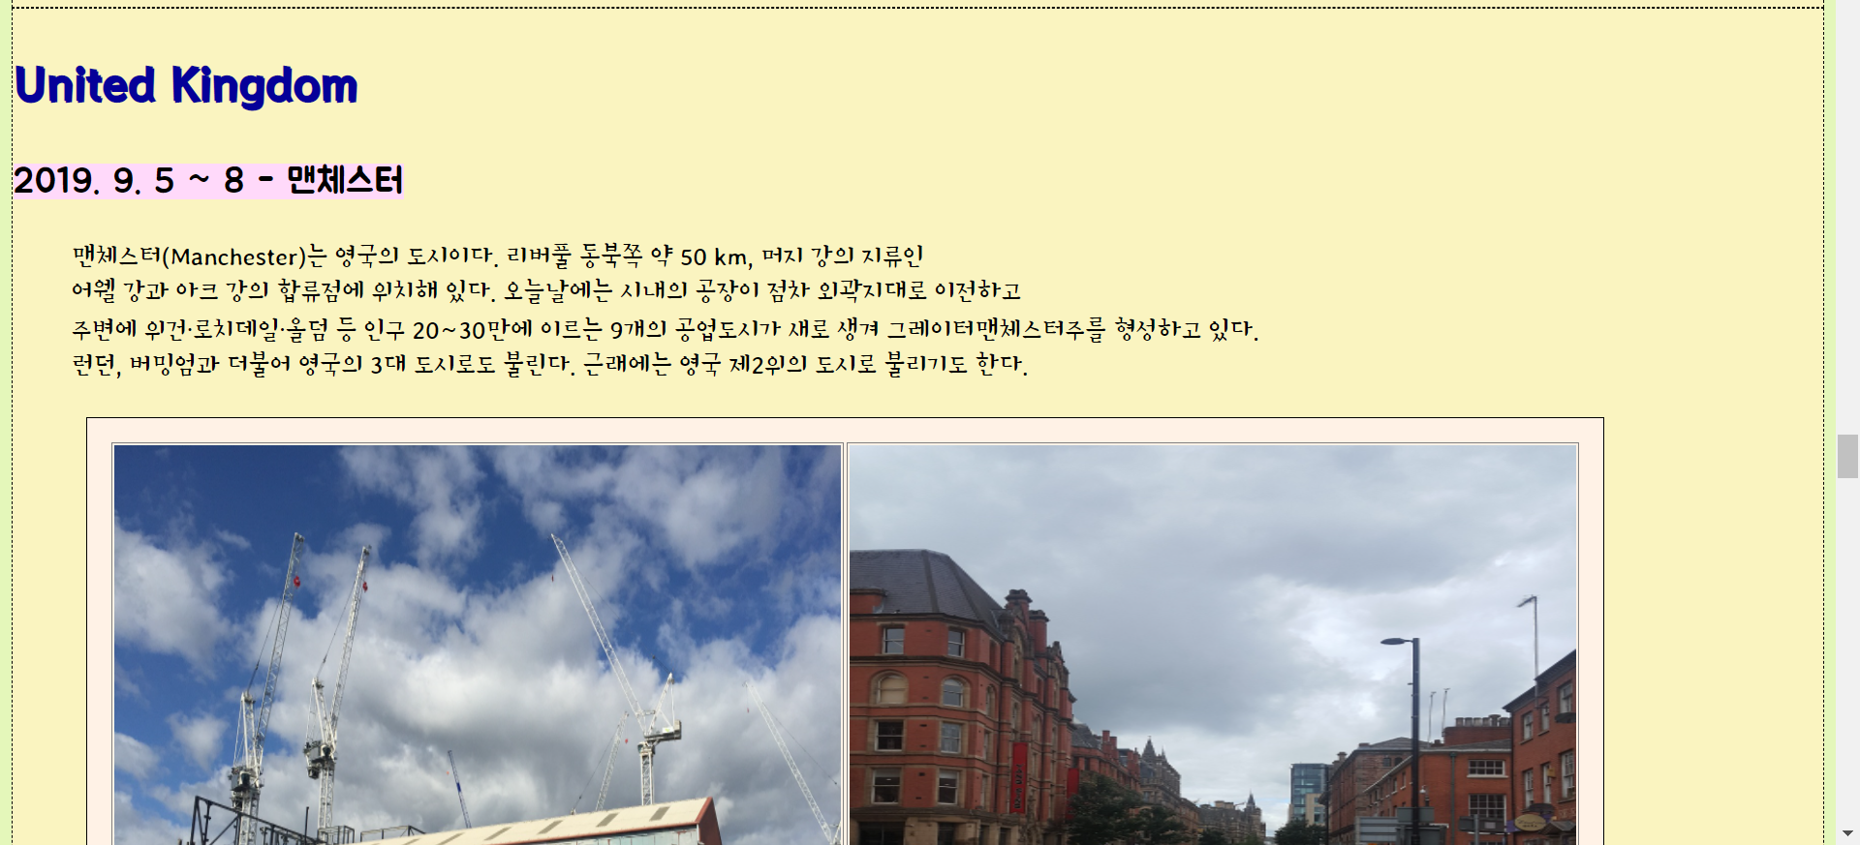
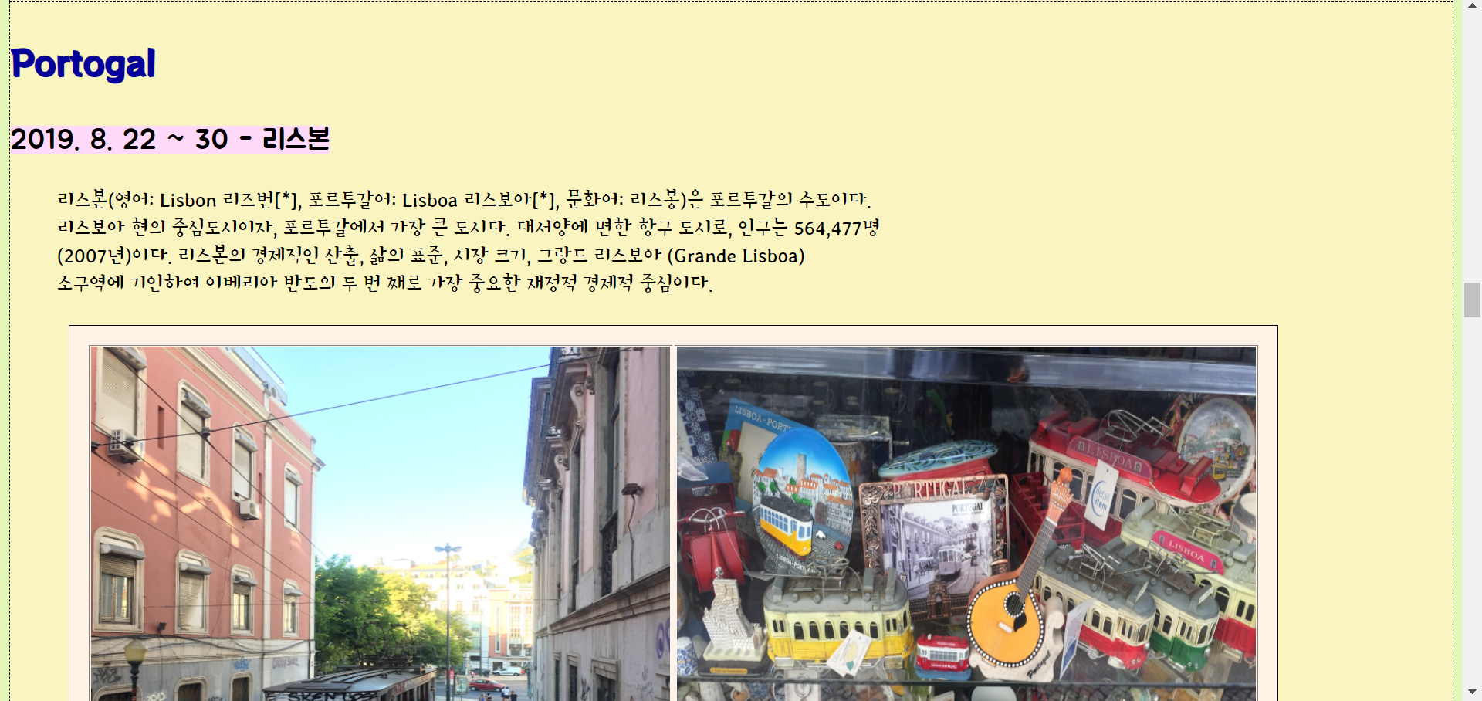
About my six-month backpacking
Western Europe 2

Slide 17
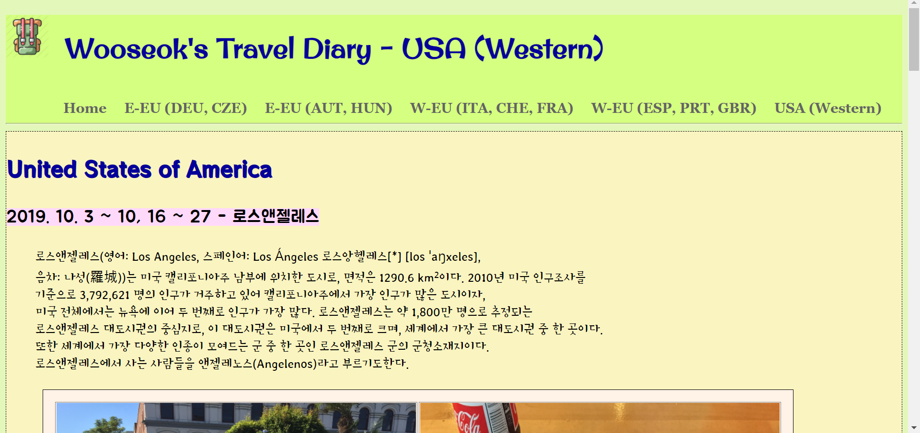
About my six-month backpacking
USA
The USA(Western) page displays information and photographs of cities visited from United States of America.

Slide 18
03
Function
1. Analysis of function utilization

Slide 19
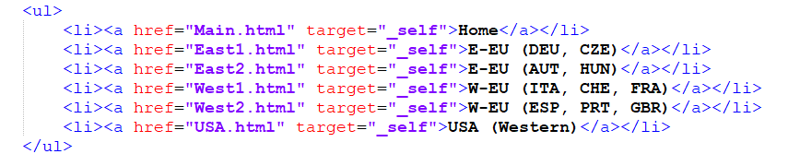
3. Function
List & Table
VENUS
I implemented nav using the List.

Slide 20
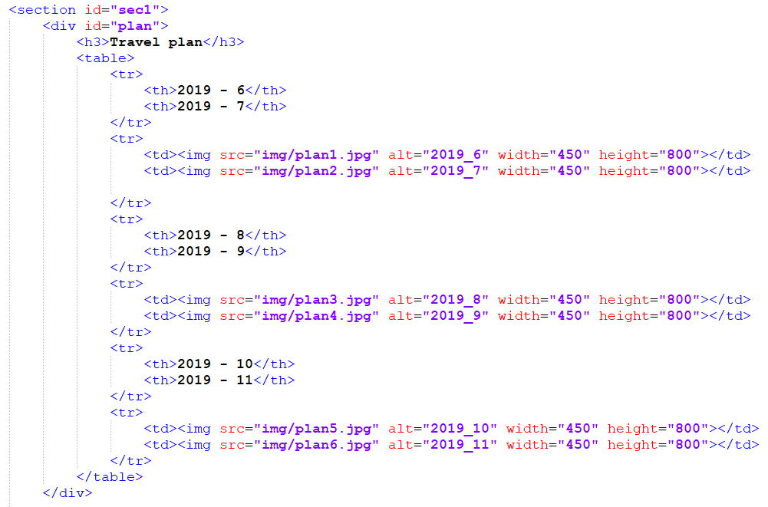
3. Function
List & Table
The contents and photos are implemented in a more pleasing way as a table.

Slide 21
3. Function
Hyperlink & Image
Hyperlinks to websites and specific locations.
Using multiple Image tags.

Slide 22
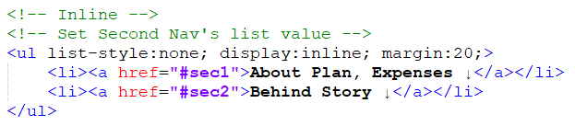
3. Function
CSS stylesheet
Inline Stylesheet

Slide 23
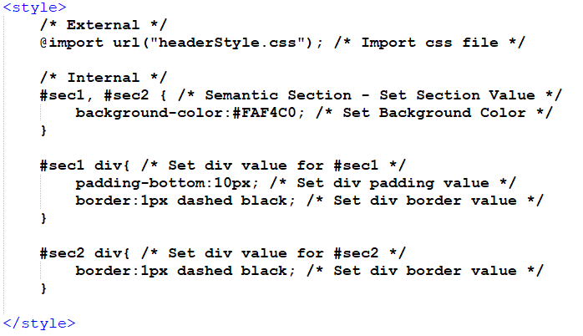
3. Function
CSS Stylesheet
Internal Stylesheet

Slide 24
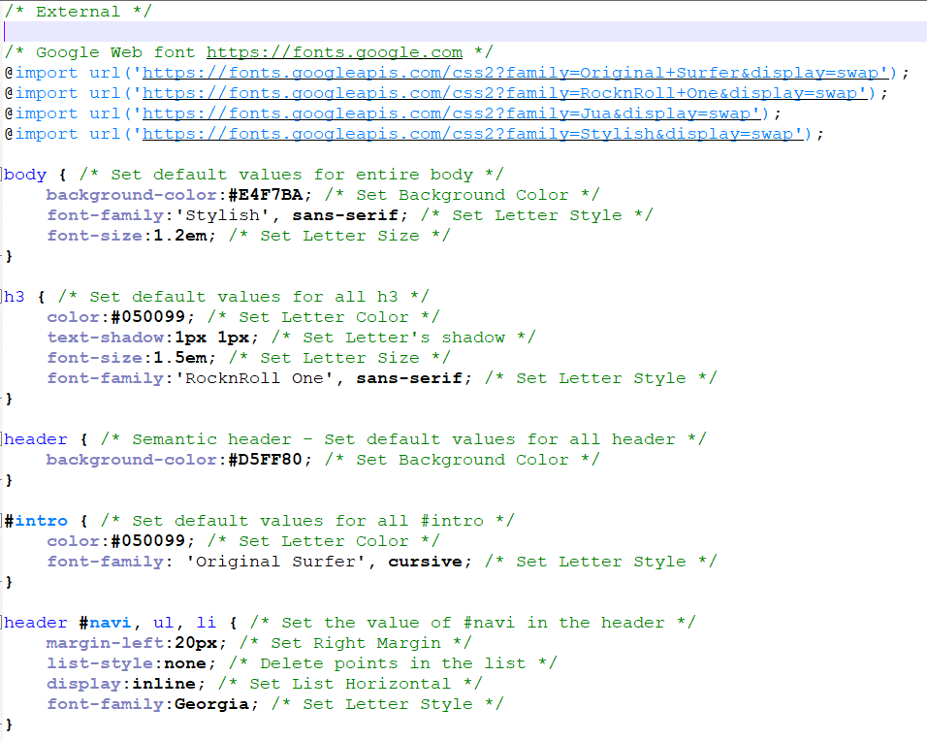
3. Function
CSS stylesheet
External Stylesheet

Slide 25
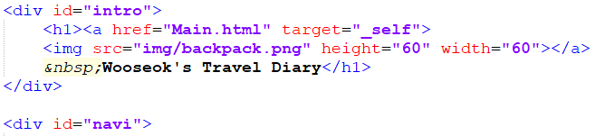
3. Function
Div & Span
Span was used to point the letters, and div was used to split the screens.

Slide 26
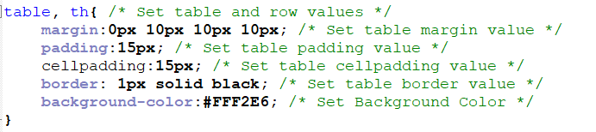
3. Function
Margin & Padding
Using margin and padding to refine style.

Slide 27
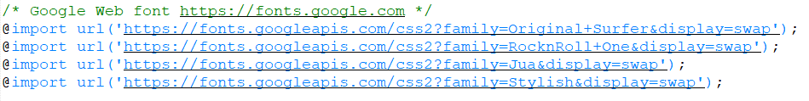
3. Function
Google Font
Using Google Font API to get 4 fonts

Slide 28
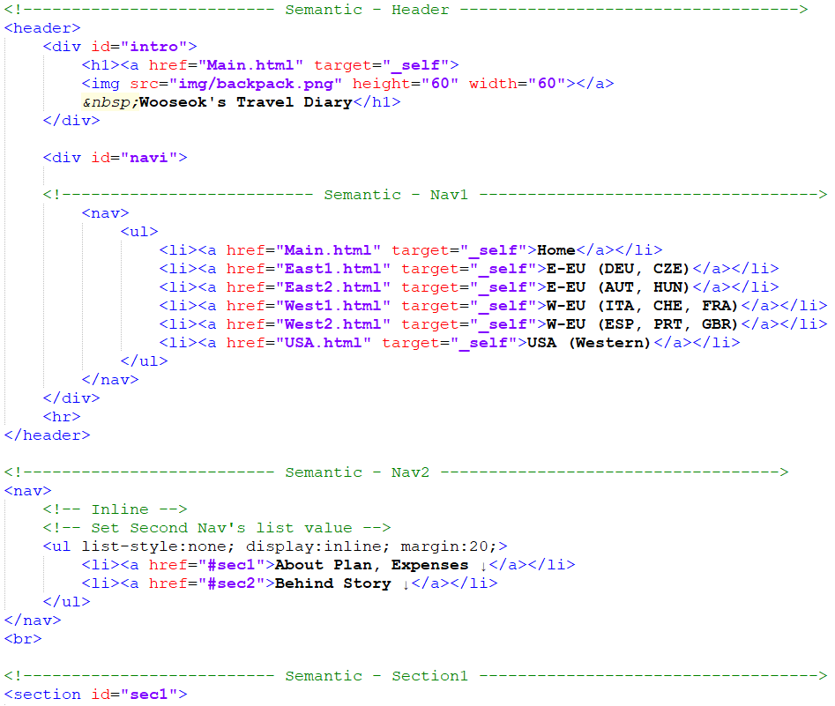
3. Function
Semantic
Use Semantic to organize code into header, nav1, nav2, section, footer.

Slide 29
3. Function
Google Font
Using Google Font API to get 4 fonts

Slide 30
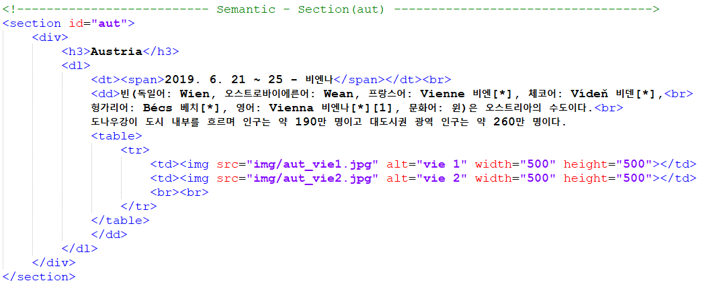
3. Function
Special thing
Using Definition tag, indentation and organization are good.

Slide 31
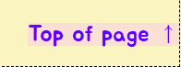

3. Function
Special thing
Tap the (Top of page) at the bottom of the page and
it will be at the top of the page.
Press the backpack and you’ll go home.

Slide 32
04
Appendix
1. Appendix

Slide 33
4. Appendix
CSS – headerStyle.css
HTML – Main.html, East1.html, East2.html,
West1.html, West2.html, USA.html
Image – backpack.png, plan1 - 6.jpg, money1 – 8.jpg, map1 – 2.jpg,
deu_fran1,2 _hi1,2 _mun1,2.jpg, cze_che1,2 _pra1,2.jpg
aut_vie1,2.jpg, hun_bud1,2.jpg, prt_prt1,2 _ris1,2.jpg
ita_cin1,2 _fir1,2 _mil1,2 _rom1,2 _ven1,2.jpg
che_bas1,2 _int1 – 4 _luz1,2 _zur1,2.jpg
fra_arl1,2 _col1,2 _mon1,2 _nic1,2 _par1 – 4 _str1,2.jpg
esp_bar1 – 4 _gra1,2 _mad1,2 _mal1,2 _sev1,2.jpg
gbr_edi1,2 _gla1,2 _liv1,2 _lon1 – 4 _man1,2 _ox1,2.jpg
usa_la1 – 4 _las1 – 4 _san1,2.jpg

Slide 34
4. Appendix
Page URL
http://qkqh8639.dothome.co.kr/Main.html

Slide 35
THANKS!
About my six-month backpacking
qkqh8639@gmail.com
+82 10 8511 8639
github.com/dntjr41
Please keep this slide for attribution

